Slide 1
Certification 201:
Steps after M/WBE Certification
State of Missouri
Office of Equal Opportunity
Vendor Office Hours

Slide 2
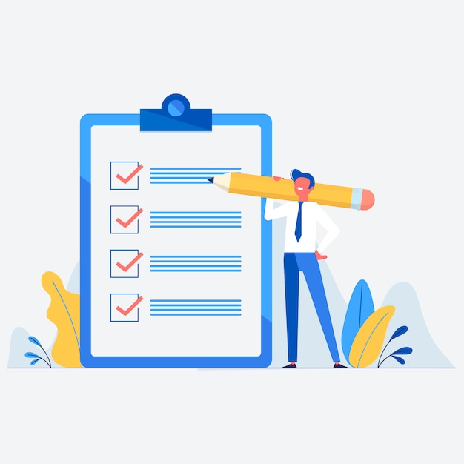
Today’s Objectives
Certification 101 Review
How Do You Look?
Where Are You Looking?
Looking Ahead

Slide 3
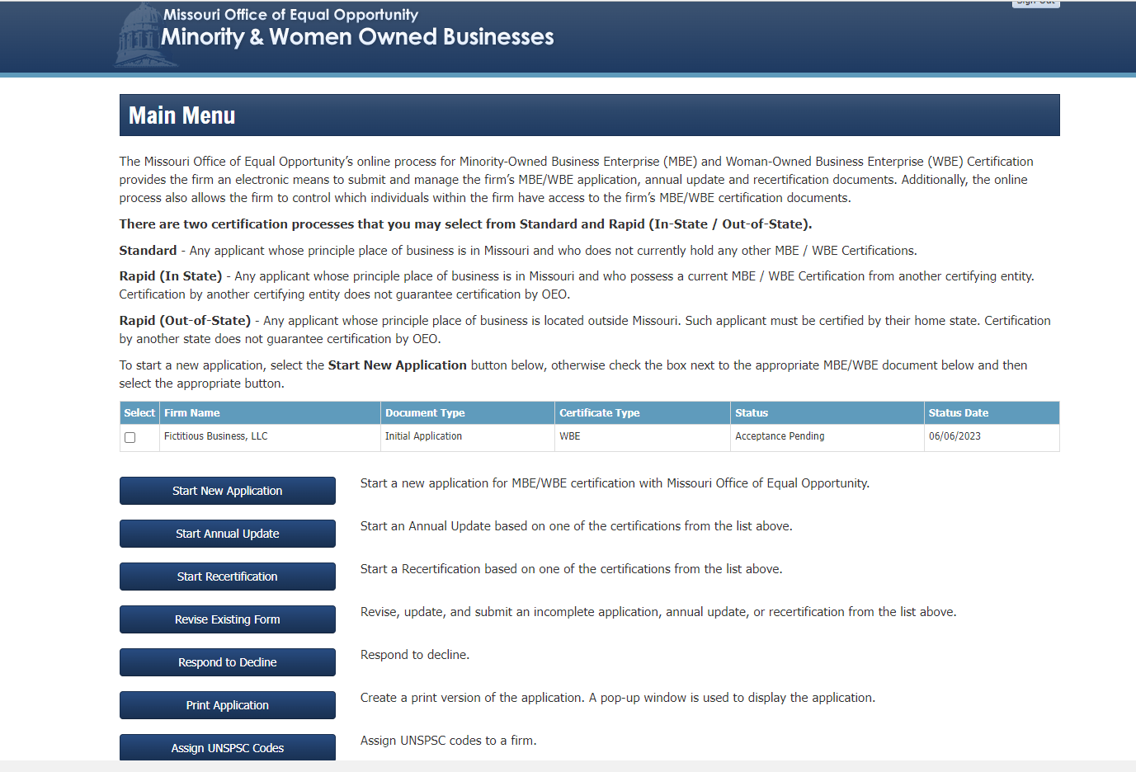
101 Review
Oeo.mo.gov – “Log in”
Maintain your Certification
  Annual Updates
    Yearly submission by the anniversary date of receiving original certification
  Recertification (3 years)
    3 years after receiving certification
    New certification anniversary changes to the date of recertification

Slide 4

Myths
Certification is:
A “silver bullet”
A guarantee
Automatically get contracts
The ultimate tool
ALL FALSE!

Slide 5

How Do You Look?
Pay close attention to:
  Contact information
  Commodities/Services on application
  Personal social media
  Website

Slide 6
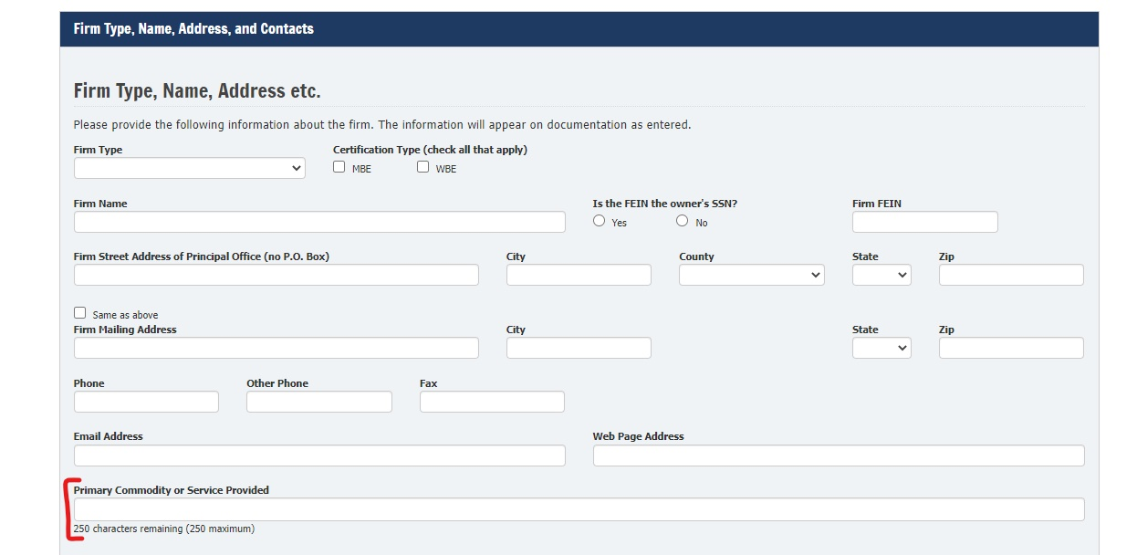
Where to Update Your Information

Slide 7
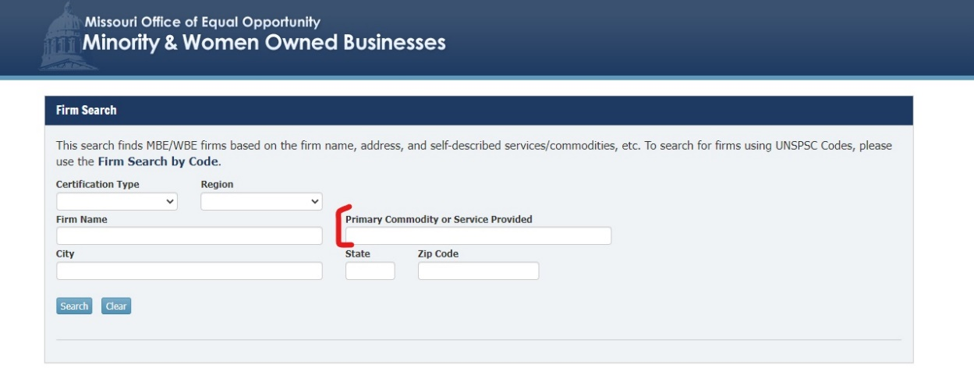
Where to Update Your Information

Slide 8
Where to Update Your Information (continued)

Slide 9

Where Are You Looking?
Contracting with the State
Up2$10K Program
Subcontracting

Slide 10
State Spending Authority
Delegated Spending Authority under MO Statute
  Division of Purchasing
    Over $100,000
  Departments
    Under $100,000
    Up2$10K
Procurement
Division of Purchasing |  | State Departments
< $10,000 = Up2$10K Program (more on future slide)
IT | Non IT | IT | Non IT
$100,000.01 | $50,000 + | $10,000.01 to $49,999.99 | $10,000.01 to $100,000

Slide 11
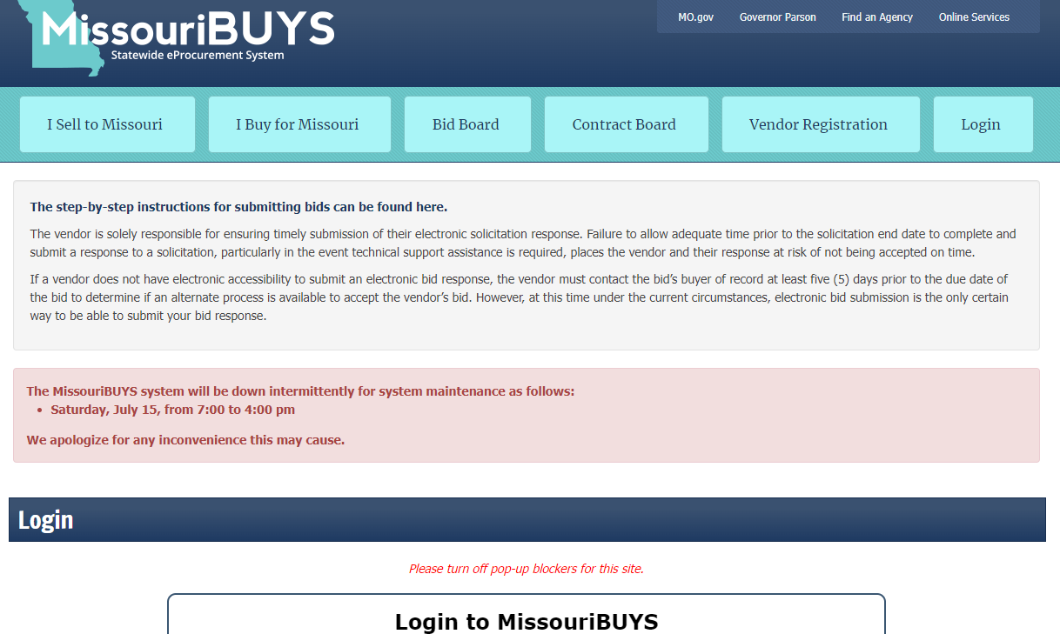
State Contracts
MissouriBuys
E-Procurement system

Slide 12
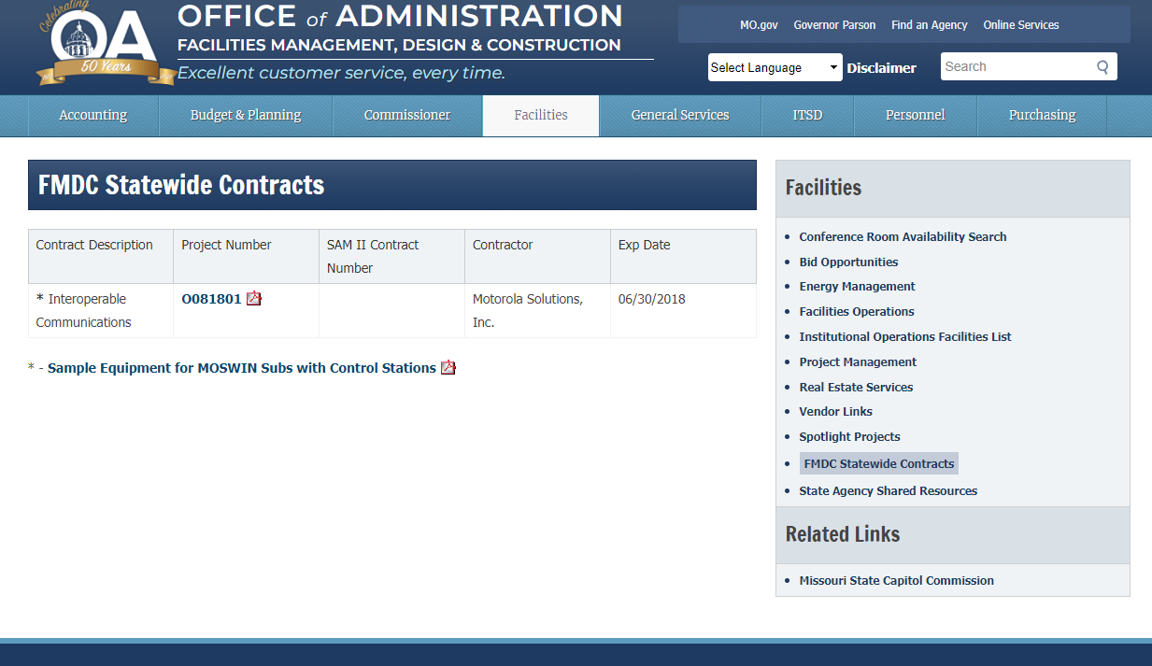
State Contracts (continued)
FMDC Bid Board

Slide 13
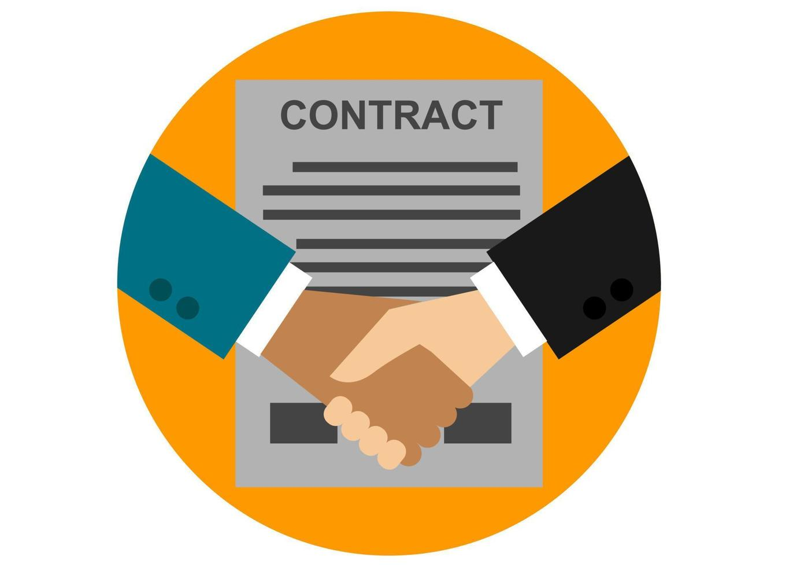
State Contracts (continued)
Up2$10K Program
Contracts with annual revenue under $10,000 spend within 12 months or 1 fiscal year do no require competitive/formal bids
Up2$10K Program Vendor Flyer

Slide 14
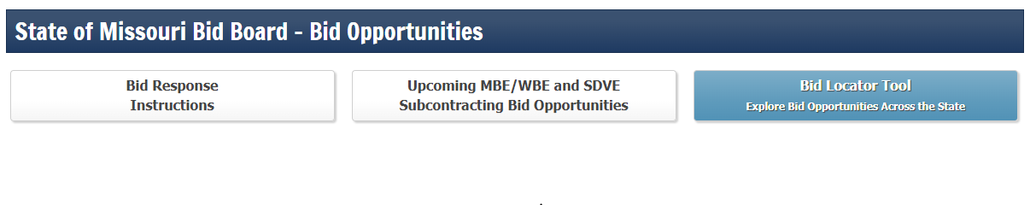
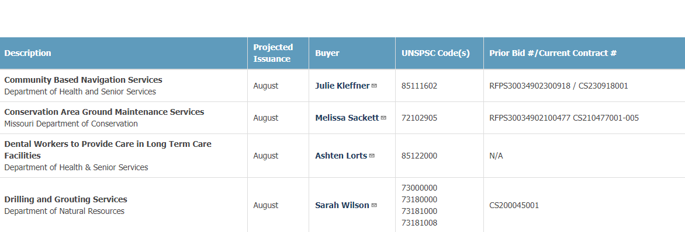
Subcontracting

Slide 15

Subcontracting (continued)
State contract -> Prime contractors
Prime contractors -> Subcontractors
No relationship between Subs and State

Slide 16
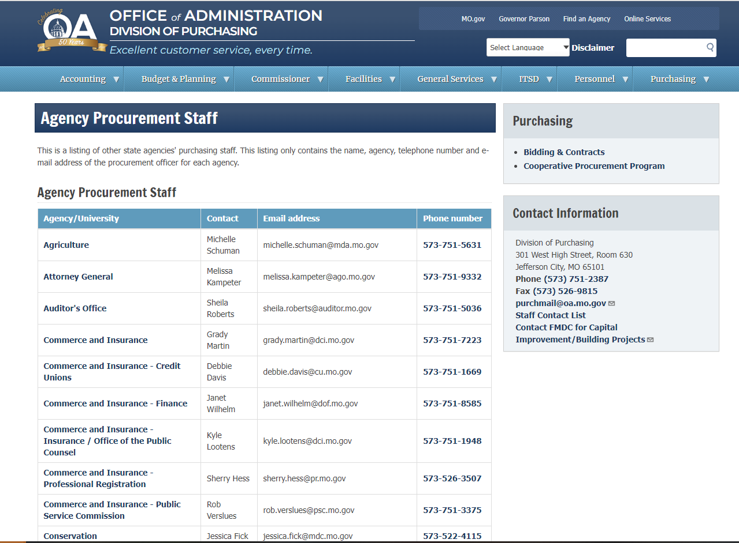
Looking Ahead
Build Relationships
Build relationships with prime vendors
Build relationships with procurement officers and buyers
MO State Purchasing Staff Contact
Network
Connect with other Small Businesses and learn from each other
Attend events and expos
Get ACCESS
Do your research
Practice your “30 second elevator pitch”

Slide 17



Next Steps: ACCESS
Information
Resources
Capital

Slide 18

Connect and Grow
Resource Organizations
State Agencies
Minority Business Development Agency
Missouri Small Business Development Center (SBDC)
Missouri Procurement Technical Assistance Centers (PTAC/APEX)
Small Business Association (SBA)
Missouri Department of Economic Development (DED)
OA - Division of Purchasing
OA – Facilities, Management, Design & Construction (FMDC)

Slide 19

Questions

